Slide 1
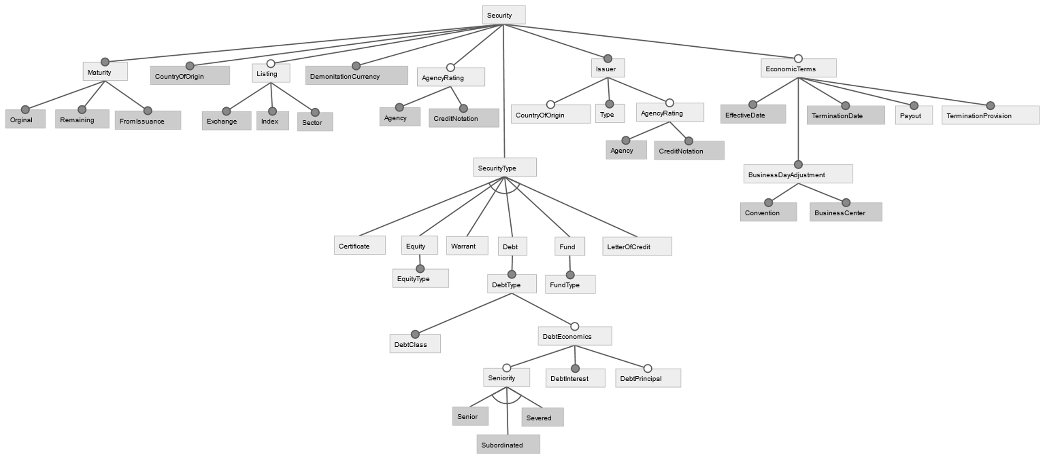
0..n
:country
:currency
0..n
0..n
:exchange
:index
:sector
:rating
:country
:date
:date
:payout
:tProvision
:rating
Type declarations
sector := {bio, chemical, …}
rating := {aaa, aa, a, bbb, bb, …}
currency := {euro, dollar, pond, ..}
country := {au,be,nl,fr,us,uk,…}
date := {dd/mm/yyyy}
fundtype := {…}
Equitytype := {…}
debtclass := {…}
debtprincipal := {…}
debtInterest := {…}
payout := {…}
tProvision:={…}
index := {bel20,..}
exchange := {euronext,…}
:equitytype
:fundtype
0..n
:debtinterst
:debtprincipal

Slide 2
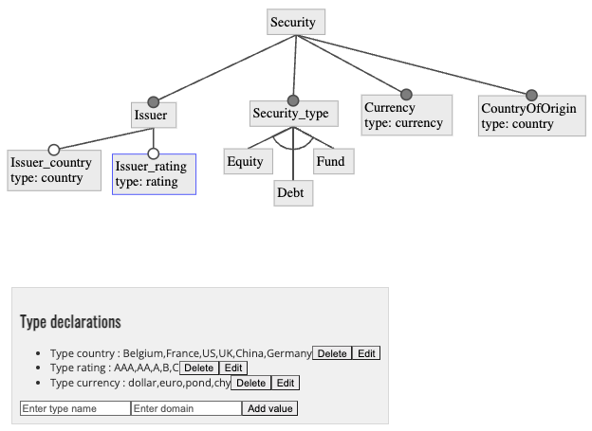

Slide 3
In case of the existence of CDM, data providers gets to view the KG of the CDM and decide which entities would fit their data.
Ex:
Security
Type
Sub-Type
Default Prob
Country of Issuance
ISIN
Fixed income, shares, ucits
Sovereign, Agency, Warrants, Options
%
Any Country

Slide 4
A model can be translated according to the standard model, embedded by annotations to restrict access.
An annotation can be provided with each entity describing the access level of each entity can be in numbers or description.
We can do the mappings using datalog rules
Data_model1
mapping
Standard model
Annotate
An annotated standardized Data_model1 datalog rules

Slide 5
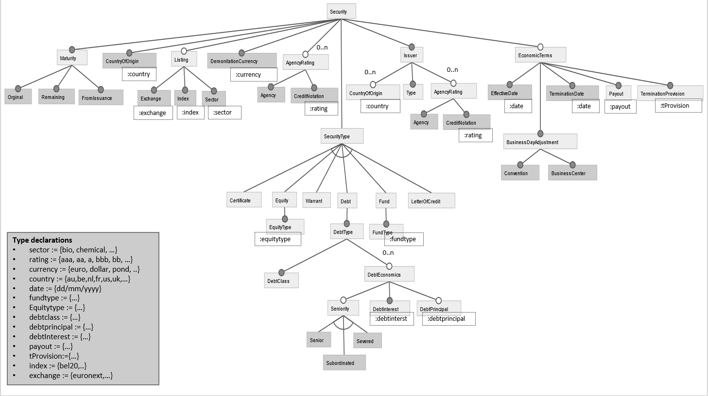

Slide 6
:Access_level
Demonition_Currency
:Access_level
:Access_level
:Access_level
Country of origins
:Access_level
:Access_level
:Access_level
:Access_level
:Access_level
KG(ID,ountryOfOrigin,ISSUER_COUNTRY) :- Data_provider1_Issuer(ID,ISSUER_COUNTRY,ISSUER_RATING).
KG_Issuer(ID,AgencyRating,ISSUER_RATING) :- Data_provider1_Issuer(ID,ISSUER_COUNTRY,ISSUER_RATING).
KG(ID,has_provider,Data_provider1) :- Data_provider1_Issuer(ID,ISSUER_COUNTRY,ISSUER_RATING).
KG(ID,DemonitionCurrency,CURRENCY) :- Data_provider1_Currency(ID,CURRENCY).
Q-is Annotation different from one data to another or it relies on data source?

Slide 7


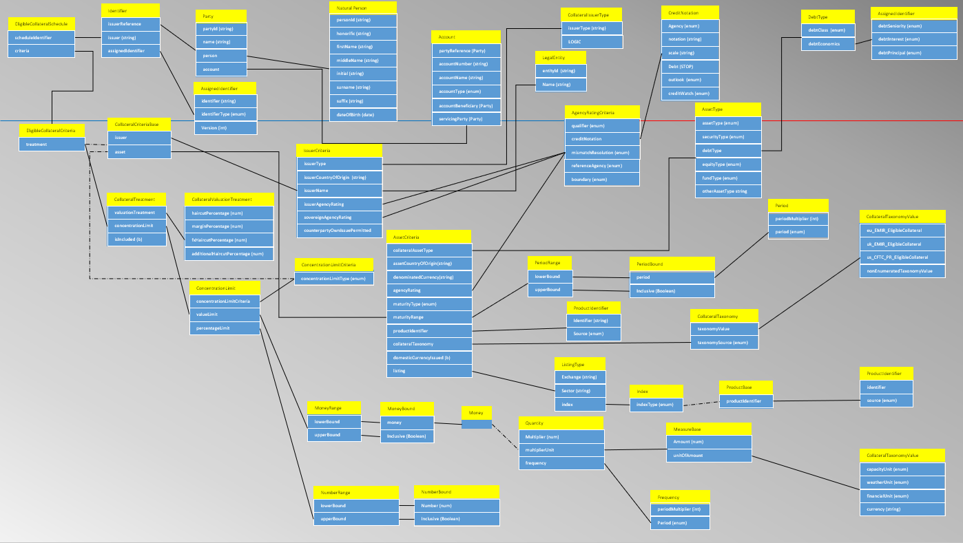


Owl
3
2
Mapping source feature model using RML to RDF
3
Mapping CDM RDF to target feature model
Mapping source feature model using RML to RDF
Mapping CDM RDF to target feature model
Create KG using OWL
1
2
Bloomberg feature model
Oscar feature model

